Slide 1
Editable List Views
11 June 2012
Notes:
Editable List Views - <number>
Guidewire training materials contain Guidewire proprietary information that is subject to confidentiality and non-disclosure agreements. You agree to use the information in this manual solely for the purpose of training to implement Guidewire software solutions. You also agree not to disclose the information in this manual to third parties or copy this manual without prior written consent from Guidewire. Guidewire training may be given only by Guidewire employees or certified Guidewire partners under the appropriate agreement with Guidewire.

Slide 2
Lesson objectives
By the end of this lesson, you should be able to:
  Configure a list view so that its rows can be modified
  Configure a list view so that rows can be added to and removed from it
  This lesson uses the notes section for additional explanation and information.
  To view the notes in PowerPoint, choose View→Normal or View→Notes Page.
  If you choose to print the notes for the lesson, be sure to select “Print hidden slides.”
Notes:
Editable List Views - <number>

Slide 3
Lesson outline
Editable list views
Iterator buttons
Notes:
Editable List Views - <number>

Slide 4
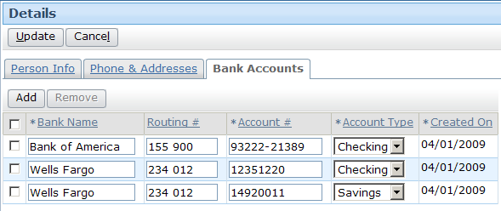
Editable list views
List views enable endusers to manipulate data, including:
  Modifying existing rows
  Adding new rows
  Removing existing rows
Notes:
Editable List Views - <number>

Slide 5
Editable hierarchy
For cell to be editable, its row iterator and every container it resides in must also be editable
List views can include editable cells (such as Account Type) and uneditable cells (such as Created On)
screen is
editable
card view is
editable
list view is
editable
row iterator is editable
Notes:
Editable List Views - <number>
The default value for the editable property of a container widget is true. Container widgets are editable by default.
There is no default value for the editable property of a row iterator. The property is blank and required, so it must always be specified.
The default value for the editable property of an atomic widget is false. Atomic widgets, such as cells, are read-only by default.

Slide 6
Multiple options for location of toolbars
Screen-level toolbar
List-level toolbar
Typically there are multiple places you can place a toolbar
  In general, toolbar should be with container it acts on
    Edit Buttons shown above act on all containers in screen
    Iterator Buttons shown above act only on given list view
Notes:
Editable List Views - <number>
Because the PCF architecture is hierarchical in nature, there is often more than one place that a toolbar could go. For example, the screenshot above shows toolbars at both the screen level and list level. Typically, the best place for a toolbar is the highest place in the hierarchy of containers that you want it to affect. For example, if you need the same toolbar on every card of a card view, then you will provide users with a more intuitive interface if you place a single toolbar at or above the card view level as opposed to putting individual toolbars on every card.

Slide 7
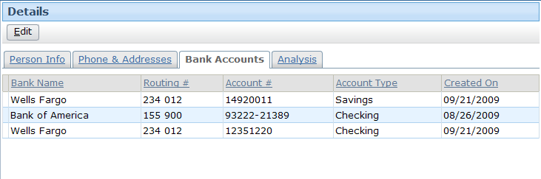
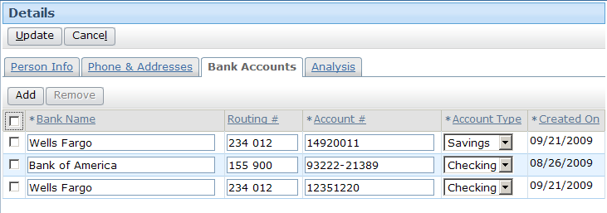
Putting lists into edit mode
To modify cell data, either:
  Location containing list view must always be in edit mode, or
  List view or one of its parent containers must have Edit Buttons
Notes:
Editable List Views - <number>
It is possible to set a location so that it is always in edit mode. To configure this, set the location's startInEditMode property to true and alwaysInEditMode property to true. A location that is always in edit mode has only Update and Cancel buttons—there is no Edit button. Whenever either of the buttons is clicked, the changes are committed or canceled, and the location immediately reverts to edit mode.

Slide 8
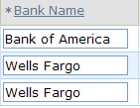
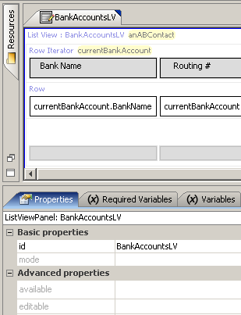
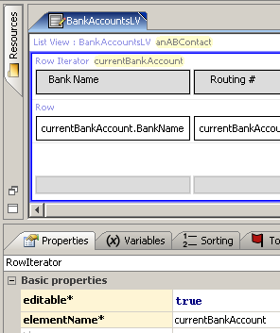
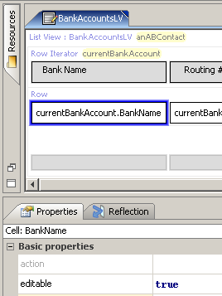
Example of cell with editable data
container default is "true"
must specify
as "true"
Notes:
Editable List Views - <number>
The screenshots above show the configuration within a list view needed to make the data in the Bank Name cells editable. Note the following about the BankAccountsLV list view:
The list view itself is editable. Editable is either blank or set to true.
The row iterator is editable.
The cell widget itself is editable.
This presumes that all container widgets that contain BankAccountsLV are also editable.

Slide 9
Lesson outline
Editable list views
Iterator buttons
Notes:
Editable List Views - <number>

Slide 10
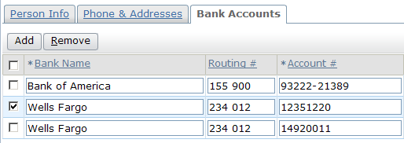
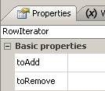
Iterator buttons and row iterators
Functionality of iterator buttons governed by properties of row iterator
  toAdd - action to take when Add is clicked
  toRemove - action to take when Remove is clicked
Notes:
Editable List Views - <number>

Slide 11
Steps to adding iterator buttons
Add iterator buttons to toolbar
Link iterator buttons to iterator
Specify toAdd property
Specify toRemove property
Configure checkbox behavior
Reload UI metadata
Notes:
Editable List Views - <number>

Slide 12
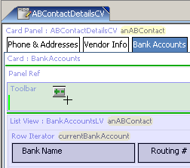
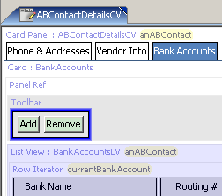
Step 1: Add iterator buttons to toolbar
Includes both Add and Remove buttons
Notes:
Editable List Views - <number>
The Iterator Buttons widget contains both buttons needed to add and remove rows. The buttons also already have the appropriate visibility logic. They are visible only when the location is in edit mode.

Slide 13
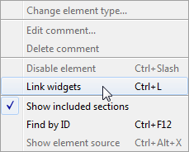
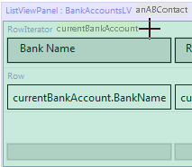
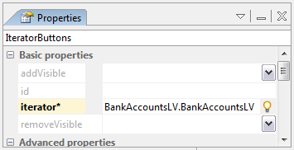

Step 2: Link iterator buttons to iterator
(1) Page Config > Link widgets
(3) Click row iterator
(4) Set iterator property
(2) Click iterator buttons
Notes:
Editable List Views - <number>
Select Page Config→Link widgets from the menu bar to link iterator buttons to an iterator. The mouse cursor changes to a crosshair, and iterator buttons on the PCF turn green to indicate that they are available for linking. If you save the PCF without linking the buttons or give focus to another application before doing so, Studio changes the buttons to red to indicate that they have not been linked.
After you click the iterator buttons, Studio renders any row iterators as green to indicate that they are available for linking. You must click the row iterator itself; even though any contained row (as well as any widget contained by any row) also appears green, they cannot be clicked.
After linking the widgets, configure the iterator property of the iterator buttons to reference the exposed iterator. Click the SmartHelp button to display a list of exposed iterators, and select the appropriate one.
Although Studio identifies iterator buttons that have not been linked to a row iterator as an error, the PCF still functions at runtime. Iterator buttons that have not been configured to explicitly reference a particular iterator will implicitly reference and affect whichever row iterator appears after them physically in the page configuration.

Slide 14
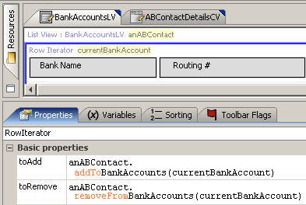
Step 3: Specify toAdd property
Syntax:
parentObj.addToarrayName(elementName)
Notes:
Editable List Views - <number>
For every array on an entity, there are inherently two methods added to that entity:
An addTo<arrayName>() method, which adds a specified object to the named array.
A removeFrom<arrayName>() method, which removes the specified object from the named array.
The addTo... method is used to enable the functionality of the Add button.
The syntax for the toAdd property is parentObj.addToArrayName(elementName), where:
parentObj is the parent object to which the array belong. In the example above, the BankAccounts array belongs to the anABContact object.
ArrayName is the name of the array.
elementName is the row iterator's element name. For an Add button, this creates a new object of the appropriate type and associates it with the array.

Slide 15
Step 4: Specify toRemove property
Syntax: parentObj.removeFromarrayName(elementName)
Notes:
Editable List Views - <number>
For every array on an entity, there are inherently two methods added to that entity:
An addTo<arrayName>() method, which adds a specified object to the named array.
A removeFrom<arrayName>() method, which removes the specified object from the named array.
The removeFrom... method is used to enable the functionality of the Remove button.
The syntax for the toRemove property is parentObj.removeFromArrayName(elementName), where:
parentObj is the parent object to which the array belongs. In the example above, the BankAccounts array belongs to the anABContact object.
ArrayName is the name of the array.
elementName is the row iterator's element name. For a Remove button, this removes the selected row or rows from the array.

Slide 16
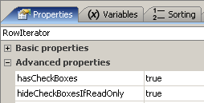
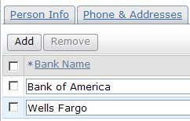
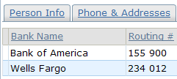
Step 5: Configure check box behavior
check boxes in edit mode
check boxes in read-only mode
Notes:
Editable List Views - <number>
Check boxes enable the Remove button by identifying which rows to remove.
hasCheckBoxes displays check boxes.
hideCheckBoxesIfReadOnly hides check boxes in read-only mode.

Slide 17
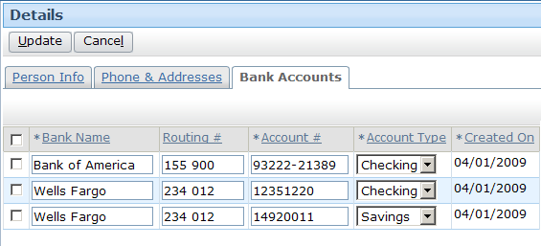
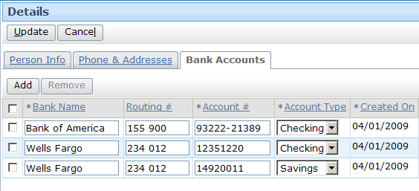
Step 6: Reload UI metadata
Deploy UI changes by entering
ALT + SHIFT + L
Notes:
Editable List Views - <number>
You should reload PCF files while in read-only mode. The screenshots above show the locations in edit mode so that the changes to the widgets are evident.

Slide 18
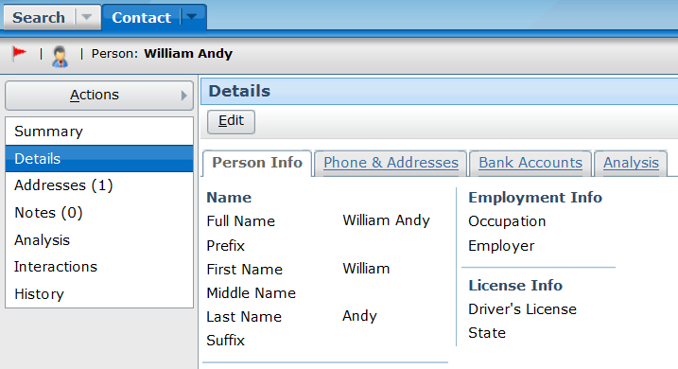
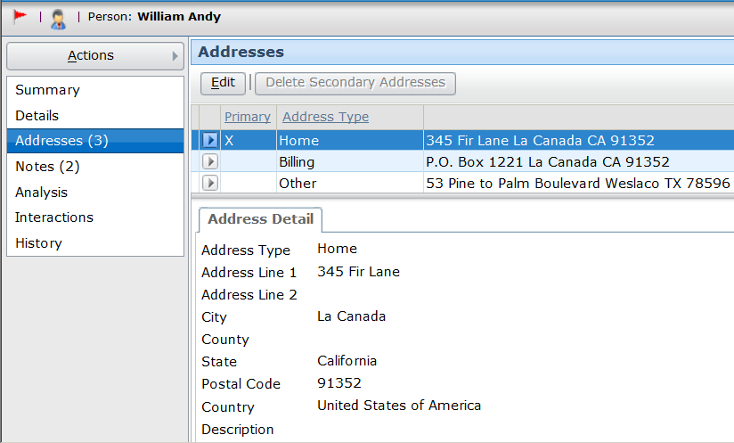
Card views and listdetail views
There are two types
of secondary views that can contain
detail views and list views
  There isn't time in
  this course to cover them in detail
  However, they are discussed in the "Additional UI Functionality" lesson, which you can review after the course
card view
listdetail view
Notes:
A card view is a collection of cards, each with one or more views.
A listdetail view consists of two views: a list view on top with one selected row and a card view on bottom that displays details about the selected row.
Editable List Views - <number>

Slide 19
Lesson objectives review
You should now be able to:
  Configure a list view so that its rows can be modified
  Configure a list view so that rows can be added to and removed from it
Notes:
Editable List Views - <number>

Slide 20
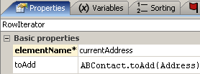
Review questions
A screen contains a card view that contains a list view. In order to make one list view cell editable, six editable properties must be implicitly or explicitly set to true. What widgets do these editable properties belong to?
When you drag an Iterator Buttons widget onto a toolbar, how many buttons are added?
Assume that an object
called anABContact
has an Addresses array
and an Addresses list
view whose row iterator
is configured as shown. Identify the errors in how the property is configured.
Notes:
Editable List Views - <number>
Answers
1. The screen, the card view, the list view, the list view's row iterator, the row, and the cell itself.
2. Two: an Add and a Remove button.
3. There are four errors: (1) The object is anABContact, not ABContact. (2) The method name starts with "addTo...", not "toAdd...". (3) The name of the array is missing from the end of the method name. (The method should be addToAddresses.) (4) The argument must reference the row iterator's element name, which is currentAddress.

Slide 21
Notices
Copyright © 2001-2012 Guidewire Software, Inc. All rights reserved.
Guidewire, Guidewire Software, Guidewire ClaimCenter, Guidewire PolicyCenter, Guidewire BillingCenter, Guidewire Reinsurance Management, Guidewire ContactManager, Guidewire Vendor Data Management, Guidewire Client Data Management, Guidewire Rating Management, Guidewire InsuranceSuite, Guidewire ContactCenter, Guidewire Studio, Gosu, Deliver Insurance Your Way, and the Guidewire logo are trademarks or registered trademarks of Guidewire Software, Inc. in the United States and/or other countries.
This material is Guidewire proprietary and confidential. The contents of this material, including product architecture details and APIs, are considered confidential and are fully protected by customer licensing confidentiality agreements and signed Non-Disclosure Agreements (NDAs).
This file and the contents herein are the property of Guidewire Software, Inc. Use of this course material is restricted to students officially registered in this specific Guidewire-instructed course, or for other use expressly authorized by Guidewire. Replication or distribution of this course material in electronic, paper, or other format is prohibited without express permission from Guidewire.
    Guidewire products are protected by one or more of the following patents: U.S. Patents 6,073,109; 6,058,413; 5,734,837; 5,630,069; 5,208,748; 7,885,831; 7,788,296.
Notes:
Editable List Views - <number>

